Slide 1
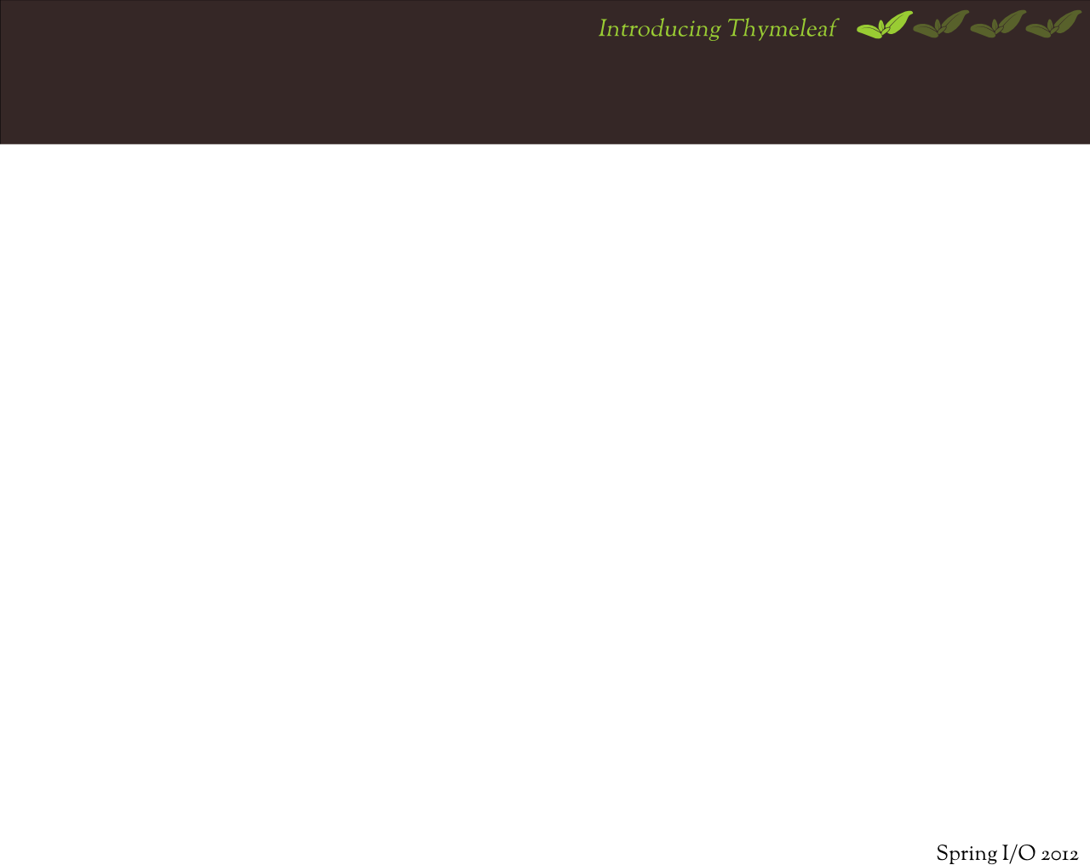
IntroducingThymeleaf
Introducing Thymeleaf
Natural templating
Let's write templates!
Present + future

Slide 2
TheProject
It's a Java Template Engine
Can be used as view layer in Spring MVC
First stable release: July 2011
Currently: 2.0.x
Elegant, configurable, extensible
21st-century feature set
FUN TO USE!

Slide 3
Atemplateengine?W hat'sthat?(I)
Not a Web Framework
Usually a part of them
Many web frameworks have their own
Takes care of the view layer
Template + Data = Document
${user.name} → John Apricot

Slide 5
TemplateenginesinSpringMVC(II)
Abstraction:
ViewResolver, View
Default: JSP + JSTL + Spring taglibs
Other integrations:
Apache Velocity
FreeMarker
Apache Tiles, XSTL, JasperReports, ...

Slide 6
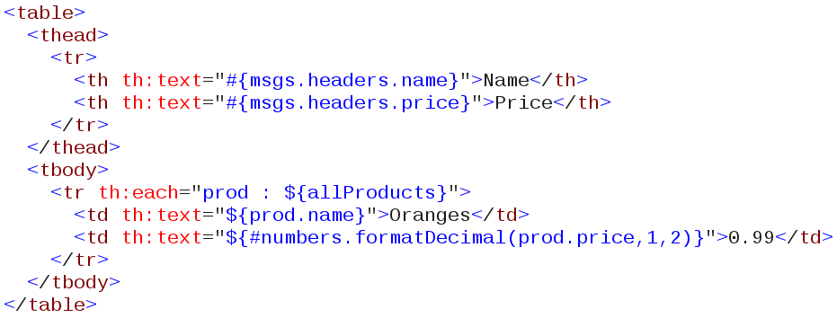
Howdoesitlooklike?

Slide 7
The(main)features
Java, DOM-based
Online (Web) or Offline (email, XML data...)
Produces XML, XHTML or HTML5
Expression eval, i18n, URL rewriting...
Full Spring MVC integration
Spring EL, form binding, i18n...
Configurable and extensible
Static prototyping abilities

Slide 8
Somefeaturesarespecial(I)
DOM-based: Especially made for the web
Web UIs are represented as DOM @ browsers
DOM allows powerful processing of documents
Thymeleaf's DOM means processing power
Better than sequential text processing

Slide 9
Somefeaturesarespecial(II)
Configurability & Extensibility
Dialects
From "create your own processor libraries"...
... to "create your own template engine"
•
Resolvers ("finders"): templates, messages...
Cache strategies
Decide what you want to call "a template"
If it's DOM-able, it's processable.

Slide 10
Somefeaturesarespecial(II)
Static prototypes
Static prototyping is not your enemy anymore
UI usually starts with static prototypes
Prototype-to-working-UI usually hard path
A new approach: NATURAL TEMPLATING!

Slide 11

NaturalTemplating
Introducing Thymeleaf
Natural templating
Let's write templates!
Present + future

Slide 12
Naturalwhat?
From Wikipedia: Template Engine (web)
“Natural Templates = the template can be a document as valid as the final result,
the engine syntax doesn't break the document's structure”

Slide 13
Howdoweevaluateit?
“valid document, don't break structure”
Templates should be statically displayable
Static = Open in browser, no web server
Templates should work as prototypes

Slide 14
Howcanthatbedone?
Take profit of browsers' display behaviour
Use custom attribs, browsers ignore them
<div exec="doit()">...</div>
No expressions inside tag bodies
<div exec="substitute_body('hello!')"> Some nice prototyping text...
</div>

Slide 15
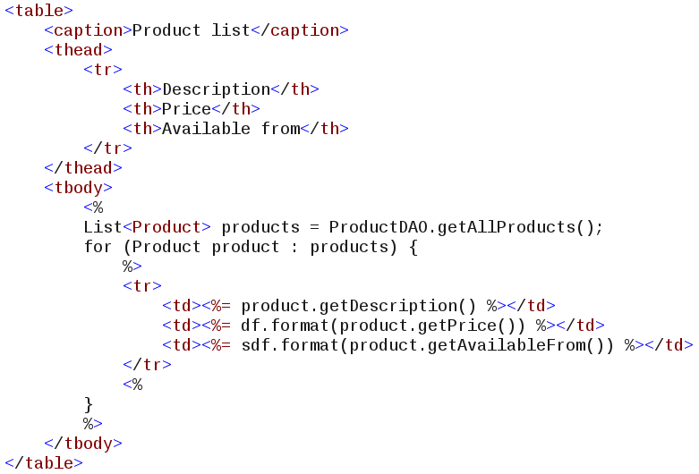
CanJSPdoit?

Slide 16
CanJSPdoit?
NO :-(

Slide 17
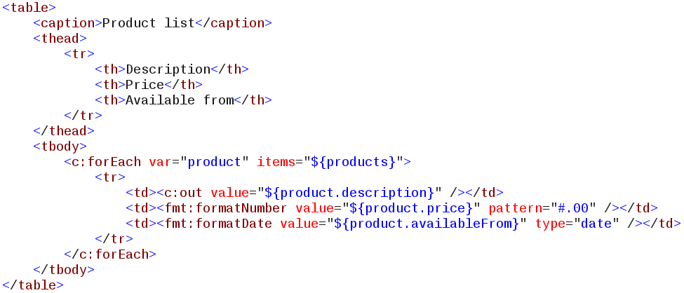
CanJSP+JSTLdoit?

Slide 18
CanJSP+JSTLdoit?
NO :-|

Slide 19
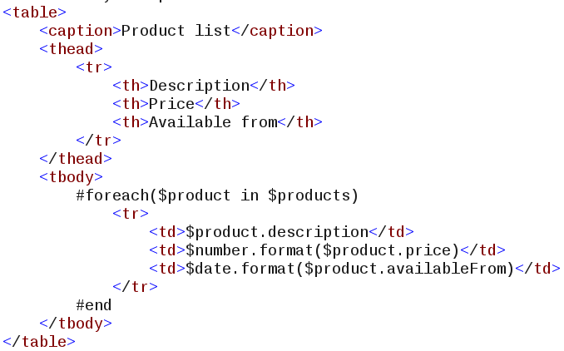
CanVelocitydoit?

Slide 20
CanVelocitydoit?
NO:o(

Slide 21
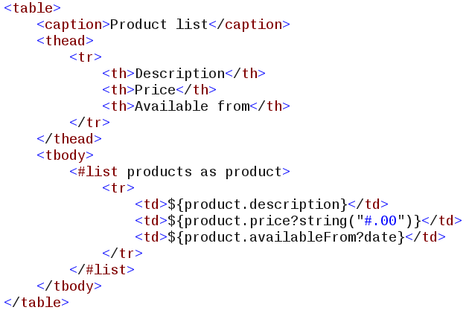
CanFreeMarkerdoit?

Slide 22
CanFreeMarkerdoit?
NO :-[

Slide 23
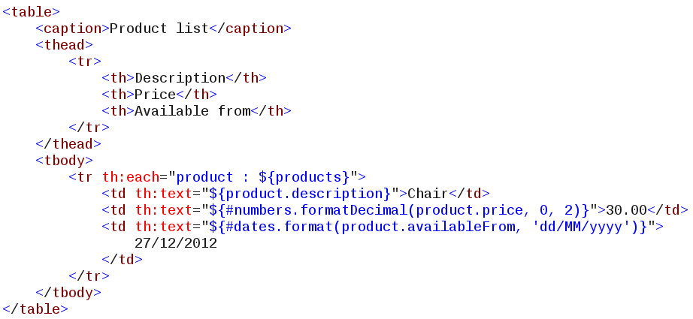
And.canThymeleafdoit?

Slide 24
And.canThymeleafdoit?
YES! ;-)

Slide 25
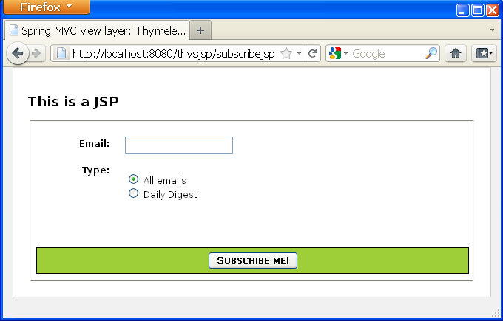
Justhowbadisnothavingthis?(I)
thvsjsp (example app): JSP on web server

Slide 26
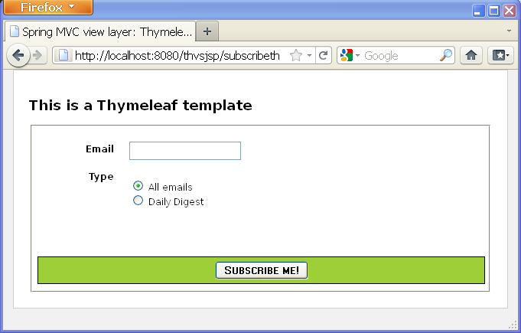
Justhowbadisnothavingthis?(II)
thvsjsp: Thymeleaf on web server

Slide 27
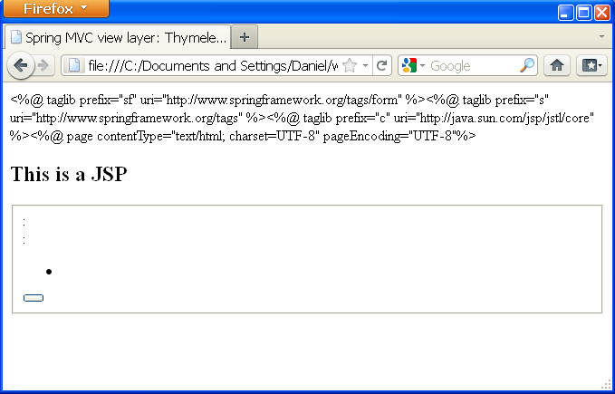
Justhowbadisnothavingthis?(II)
thvsjsp: JSP statically displayed

Slide 28
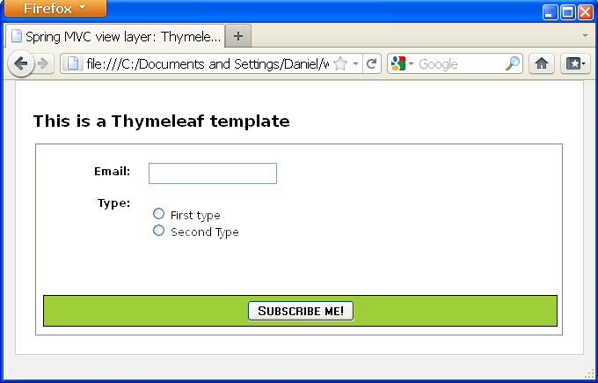
Justhowbadisnothavingthis?(IV)
thvsjsp: Thymeleaf statically displayed

Slide 29

Let'swritetemplates!
Introducing Thymeleaf
Natural templating
Let's write templates!
Present + future

Slide 30
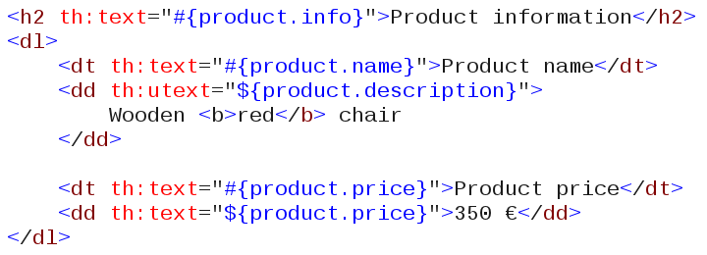
Writingtexts
th:text HTML-escaped text (default)
th:utext unescaped text

Slide 31
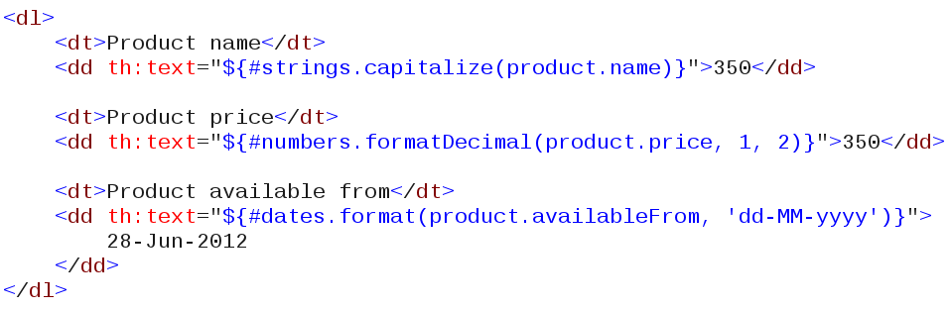
Formatting
#dates, #calendars, #numbers, #strings...

Slide 32
URLs
@{...} syntax
...produces...
Automatic URL-rewriting is performed

Slide 33
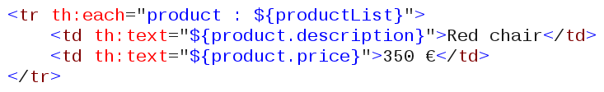
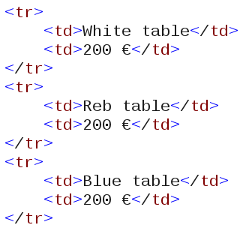
Iteration
th:each
...produces...

Slide 34
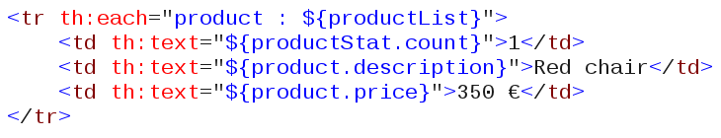
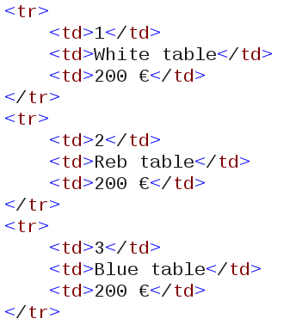
Iterationstatus
th:each
...produces...

Slide 35
Conditionals(I)
th:if
th:unless

Slide 36
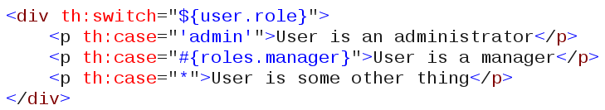
Conditionals(II)
th:switch / th:case

Slide 37
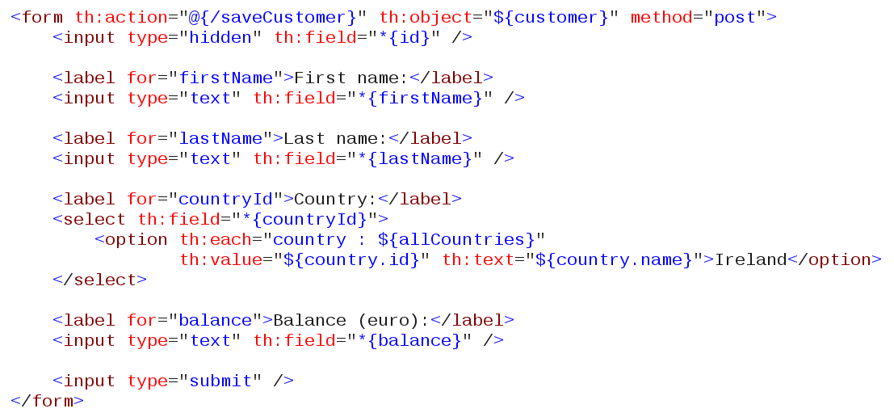
Formsandbean-binding(I)
th:object, th:field

Slide 38
Formsandbean-binding(II)
Forms integrate fully with Spring
th:field acts exactly as Spring taglib tags
Slightly different behaviour depending on host tag
PropertyEditors work OK
Spring EL expressions in th:field work OK
Validations work OK (th:errors)

Slide 39
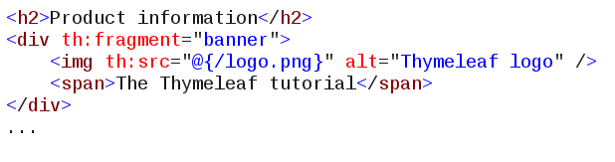


Pagecomposition
Declare fragment with th:fragment
Reuse th:include
...and reuse again...

Slide 40
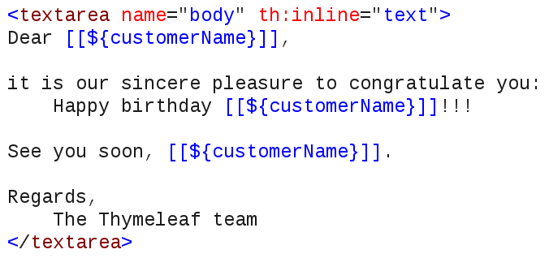
Inlining
Text, Javascript and Dart inlining
th:inline="text"|"javascript"|"dart"

Slide 41

W heretogo,whatosee.
Documentation, articles, code examples
http://www.thymeleaf.org/documentation.html
User forum
http://forum.thymeleaf.org/
Twitter
@thymeleaf

